Slide 1
LINQ (Langague INtegrated Query) 소개 (통합 언어 쿼리)
리얼웹 개발본부
2008. 05
ms-help://MS.VSCC.v90/MS.MSDNQTR.v90.ko/dv_linq/html/a73c4aec-5d15-4e98-b962-1274021ea93d.htm
배포 금지

Slide 2
0. 산출물 정보 및 문서이력
문서 요약
프로젝트 명 | 세미나 | 문서번호
구분 |  | 작성자 | 배성혁
작성일자 | 2008.05.08 | 버전 | 1.0
단계 | 작성 | 기타
문서 이력
번호 | 변경일자 | 변경자 | 승인자 | 내용
1.0 | 2008.05.08 | 배성혁 |  | 최초 작성

Slide 3
0. 목차
LINQ Overview
LINQ Objectives
LINQ to Object – Samples
LINQ to ADO.NET (지들은 LINQ to Relational)
LINQ to SQL
LINQ to DataSet
LINQ to Entities
LINQ to XML Feature & Samples

Slide 4
The LINQ Project
C# 3.0
Visual Basic 9.0
Others
LINQ building blocks
Expression Tree
Query expression
Query operators
LINQ Providers
LINQ to Objects
LINQ to DataSets
LINQ to SQL
LINQ to Entities
LINQ to XML
…
<book>
<title/>
<author/>
<year/>
<price/>
</book>
Objects
Relational
XML

Slide 5
LINQ (통합 언어 질의문) 필요성
Common Problems
Data != Objects (OOP and Relation mismatches) ➔ Data == Objects
Operation to Object, Relational, Xml, etc…
DataSource에 대한 일관적인 Operation 제공
Relational Database, Tables, XML, Web Services 등의 다양한 DataSource에 대한 똑같은 Operation 적용 필요성
Language상에서 다양한 DataSource의 Data를 동격의 Objects로 통합 관리
예) XML Element와 SQL DB의 Table을 join 한다.
예) Object graph 와 Web Services 의 ResultSet을 join, filtering 을 수행한다.
Data 처리에 가장 범용적이고 강력한 SQL, XQuery와 유사한 기능이 필요

Slide 6
LINQ Objectives
New programming model for data access that integrates query support directly within the .NET languages
Designed to reduce the complexity when working with data
Query operators can be used against any collection
Built-in examples: Select, Where, GroupBy, Join, etc.
Extensibility model supports extending/replacing these
Benefits
Work with data in a consistent way, regardless of the type of data
Interact with data as objects
Better integration with programming languages
Improved productivity through IntelliSense in Visual Studio

Slide 7
Query Operations
Family | Query Operations | Description
Filtering | Where, OfType
Projection | Select, SelectMany
Partitioning | Skip, SkipWhile, Take, TakeWhile
Join | GroupJoin, Join
Concatenation | Concat
Ordering | OrderBy, OrderByDescending, Reverse, ThenBy, ThenByDescending
Grouping | GroupBy, ToLookup
Set | Distinct, Except, Intersect, Union
Conversion | AsEnumerable, AsQueryable, Cast, ToArray, ToDictionary, ToList
Equality | SequenceEqual
Generation | DefaultIfEmpty, Empty, Range, Repeat | Outer join시 null
Quantifiers | All, Any, Contains
Aggregation | Aggregation, Average, Count, LongCount, Max, Min, Sum

Slide 8
LINQ to Objects Sample
Filtering
Grouping
var titles
= books
.Where(book =>book.Title.Contains("Action"))
.Select(book => book.Title);
var groups2
= from book in SampleData.Books
group book by book.Publisher into publisherBooks
select new { Publisher = publisherBooks.Key.Name, Books = publisherBooks };
Ordering
Inner Join
var titles
= books
.Where(book =>book.Title.Contains("Action"))
.Select(book => book.Title)
.OrderBy(book => book.Title)
.ThenBy(book => book.Publisher);
var publisherBooks
= from publisher in SampleData.Publishers
join book in SampleData.Books
on publisher equals book.Publisher
select new { Publisher = publisher.Name, Book = book.Title };
Outer Join
var query = from publisher in SampleData.Publishers
join book in SampleData.Books
on publisher equals book.Publisher into publisherBooks
from book in publisherBooks.DefaultIfEmpty()
select new
{
Publisher = publisher.Name,
Book = (book == default(Book) ? "(no books)" : book.Title)
};

Slide 9
LINQ to ADO.NET ( Relationa)
LINQ to SQL – Strongly Typed Database
Emphasis on rapid application development
Direct mapping to Microsoft SQL Server family of databases
Release in Microsoft Visual Studio 2008 RTM
LINQ to Entities – Flexible mapping to existing Schema
Focus on enterprise-grade data scenarios
Flexible Mapping to Microsoft SQL Server and third-party databases
Release in Microsoft Visual Studio 2008 update
CTPs on top of Microsoft Visual Studio 2008 Betas/RTM
LINQ to DataSet – In-Memory Cache w/Change Tracking
All the scenarios where DataSet is useful today
Offline, Disconnected, Aggregation
Change Tracking
..Plus support for Query Operations
Strongly typed or Untyped DataSet Support
Release in Microsoft Visual Studio 2008 RTM

Slide 10
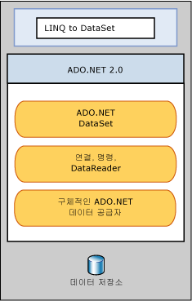
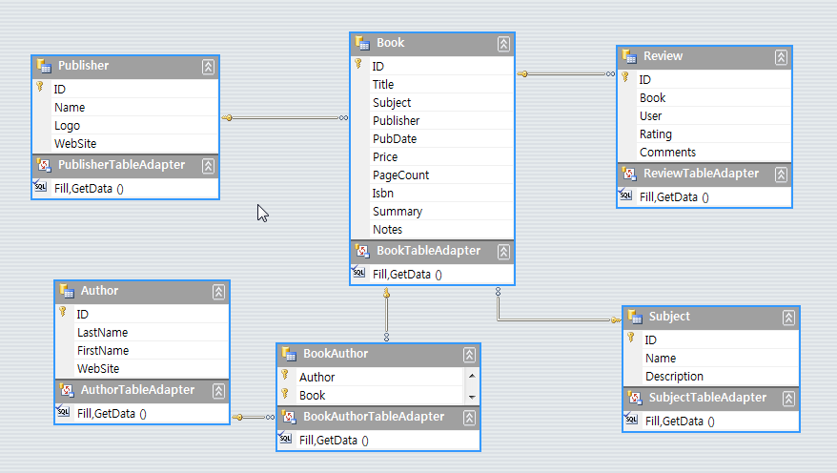
LINQ to DataSet
LINQ to DataSet을 사용하면 DataSet 개체에 캐시된 데이터를 쉽고 빠르게 쿼리할 수 있습니다.
특히, LINQ to DataSet을 사용하면 별도의 쿼리 언어를 사용하는 대신 프로그래밍 언어 자체에서 쿼리를 작성할 수 있으므로 간편하게 쿼리할 수 있습니다.
이 기능은 Visual Studio에서 제공되는 컴파일 타임 구문 검사, 정적 입력 및 IntelliSense 지원을 해당 쿼리에 사용할 수 있는 Visual Studio 개발자에게 특히 유용합니다.
ms-help://MS.VSCC.v90/MS.MSDNQTR.v90.ko/wd_linqadonet/html/743e3755-3ecb-45a2-8d9b-9ed41f0dcf17.htm

Slide 11
LINQ to DataSet (Untyped DataSet / Typed DataSet)
Untyped DataSet
Call AsEnumerable() on DataTable
Reference Fields by Name
Use Field<T>(columnName)
Project out fields for strongly typed result
Typed DataSet
Use strongly typed accessors
var query = from row in myDataSet.Tables["Customers"].AsEnumerable()
where row .Field<string>("City") == "London"
select new { row.Field <string> ("CustomerID"),
row.Field <string> ("ContactName") } ;
var query = from customer in northwind.Customers
where customer.City == "London"
select customer;

Slide 12
LINQ to DataSet - Samples
ADO.NET을 이용한 Untyped DataSet Build
var dataAdapter
= new SqlDataAdapter(
@"SELECT ID, Name from Publisher
;
SELECT ID, Title, Subject, Publisher, Price from Book
WHERE DATEPART(YEAR, PubDate) > 1950",
Properties.Settings.Default.liaConnectionString);
dataAdapter.TableMappings.Add("Table", "Publisher");
dataAdapter.TableMappings.Add("Table1", "Book");
dataAdapter.Fill(dataSet);
LINQ 이용한 DataSet Build
var linqBooks = new LinqBooksDataContext(Properties.Settings.Default.liaConnectionString); // LINQ to SQL 사용
var publisherQuery
= linqBooks.Publishers.Select(publisher => new { publisher.ID, publisher.Name }); // Projection
var bookQuery = from book in linqBooks.Books
where book.PubDate.Value.Year > 1950
select new
{
book.ID,
book.Title,
book.Subject,
book.Publisher,
Price = book.Price ?? 0
};
dataSet.Tables.Add(publisherQuery.ToDataTable()); // ToDataTable은 extension method, instance to DataTable using reflection
dataSet.Tables.Add(bookQuery.ToDataTable());

Slide 13
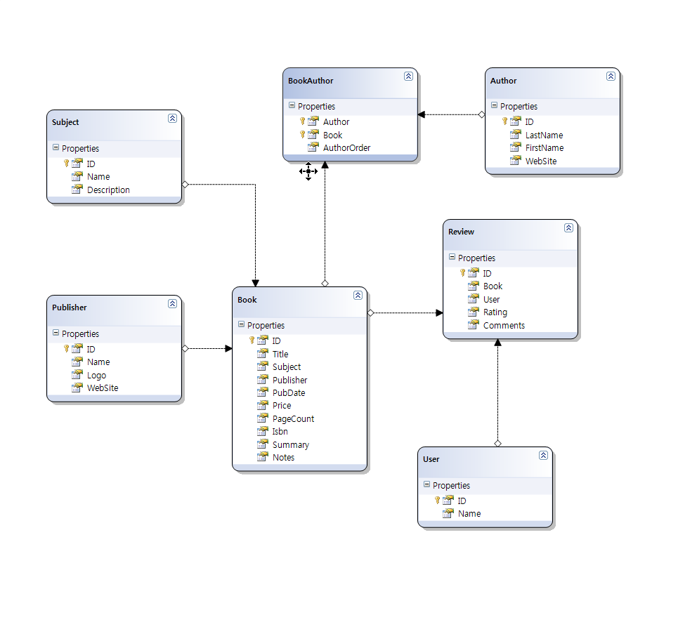
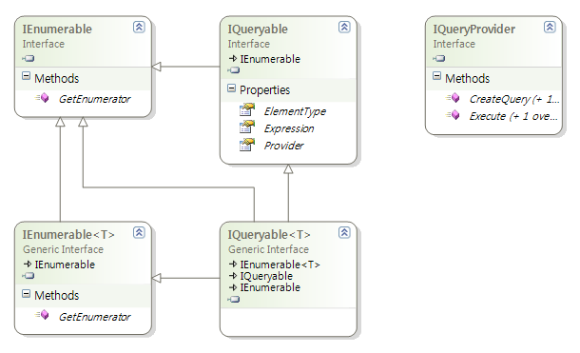
LINQ to SQL
LINQ to Objects
LINQ to Others

Slide 14
LINQ to Entities
Mapping
MSL
(Mapping Schema Language)
Mapping
MSL
(Mapping Schema Language)
Logical
SSDL
(Store Schema definition Langague)
AuthorClass
Author Entity
Author
Data Source
Human
Address
PublisherClass
Publisher
Entity
Publisher
http://msdn.microsoft.com/ko-kr/magazine/cc163286.aspx

Slide 15
LINQ to XML - 비교
LINQ to XML 특성 | XML DOM 특성
Element-centric | Document-centric
Declarative model | Imperative Model
Xml document의 구조와 유사한 Code 작성 가능 | Xml document 구조와 상이한 Code
Element 및 Attribute 생성을 한 생성자 수행 가능 | 많은 코드 수반
XML Namespace 처리 단순화 | XML Namespace manager 필요. 복잡함
Faster and smaller | 무겁고, CPU Intensive
Streaming capabilities | Everything is loaded in memory
Symmetry in element and attributes APIs | XmlElement, XmlAttributes 등 다양한 Interface 숙지 필요

Slide 16
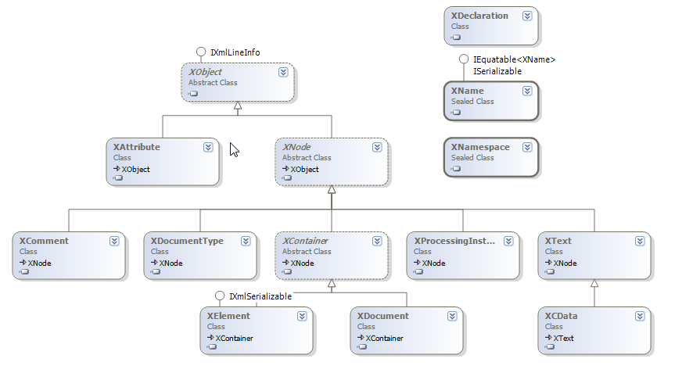
LINQ to XML - Classes

Slide 17
LINQ to XML (예제)
LINQ to XML | XML DOM
XElement xml = new XElement(“books”, from book in books where book.Year == 2006 select new XElement(“book”, new XAttribute(“title”, book.Title), new XElement(“publisher”, book.Publisher) ) ); | XmlDocument doc = new XmlDocument(); XmlElement root = doc.CreateElement(“books”); foreach(Book book in books) { if(book.Year == 2006) { XmlElement element = doc.CreateElement(“book”); element.SetAttribute(“title”, book.Title); XmlElement publisher = doc.CreateElement(“publisher”); publisher.InnerText = book.Publisher; element.AppendChild(publisher); root.AppendChild(element); } }
<books>
<book title=“Ajax in Action”>
<publisher>Manning</publisher>
</book>
<book title=“Ajax in Action”>
<publisher>Manning</publisher>
</book>
</book>

Slide 18













Subprocess
Groups
Groups
Task
Groups
Subprocess
End

